Slide 1

Python Inheritance

Slide 2
Outline
Python Inheritance
Types of Inheritance
The super method
Method Resolution Order (MRO)
Super vs Explicit inheritance

Slide 3
Python Inheritance
Allows us to define a class that inherits all the methods(behaviors) and properties(states) from another class.
Parent class is the class being inherited from, also called base class.
Child class is the class that inherits from another class, also called derived class.

Slide 4
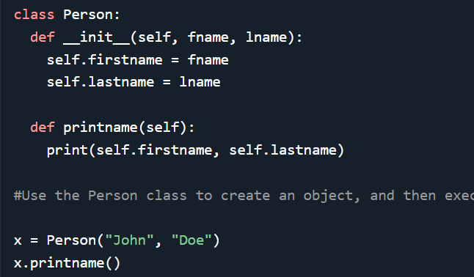
Create a Parent Class
Any class can be a parent class, so the syntax is the same as creating any other class:
Create a class named Person, with firstname and lastname properties, and a printname method:

Slide 5

Create a Child Class
To create a class that inherits the functionality from another class, send the parent class as a parameter when creating the child class:
Create a class named Student, which will inherit the properties(states) and methods(behaviors) from the Person class:

Slide 6

Execute inheritance
Now the Student class has the same properties and methods as the Person class.
Use the Student class to create an object, and then execute the printname method:

Slide 7

Add the __init__() Function
A child class that inherits the properties and methods from its parent.
Add the __init__() function can be added to the child class.
Add the __init__() function to the Student class:
When you add the __init__() function, the child class will no longer inherit the parent's __init__() function.
The child's __init__() function overrides the inheritance of the parent's __init__() function.

Slide 8

Retaining the inheritance
To keep the inheritance of the parent's __init__() function, add a call to the parent's __init__() function:
The example adds the __init__() function, and kept the inheritance of the parent class, and we are ready to add functionality in the __init__() function.

Slide 9

Types of Inheritance in Python

Slide 10
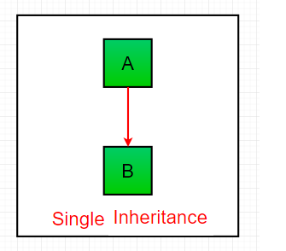
Single Inheritance
Enables a derived class to inherit properties from a single parent class, thus enabling code reusability and the addition of new features to existing code.

Slide 11
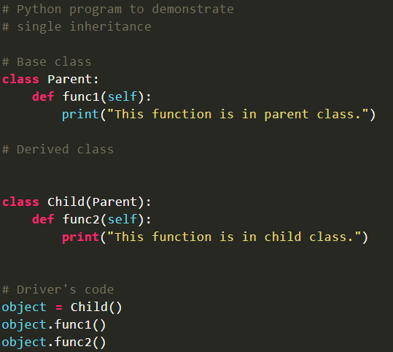

Sample single inheritance

Slide 12
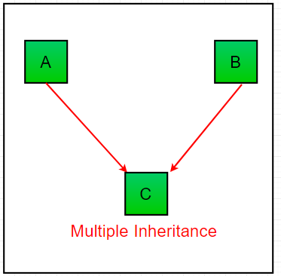
Multiple inheritance
When a class can be derived from more than one base class this type of inheritance is called multiple inheritances. In multiple inheritances, all the features of the base classes are inherited into the derived class.

Slide 13
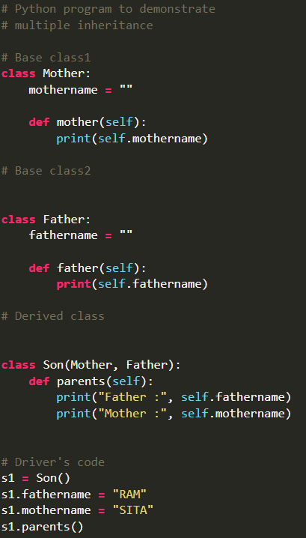

Multiple Inheritance sample

Slide 14
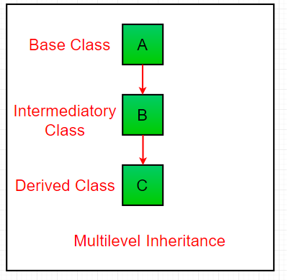
Multilevel inheritance
In multilevel inheritance, features of the base class and the derived class are further inherited into the new derived class. This is similar to a relationship representing a child and a grandfather.

Slide 15
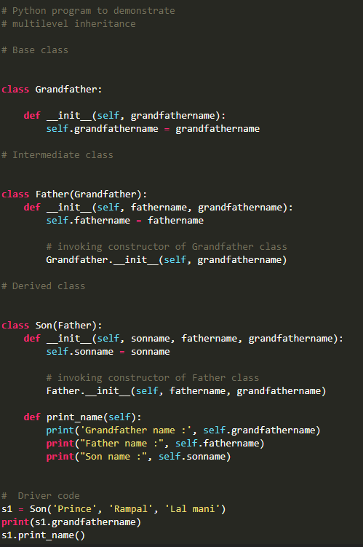
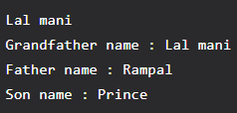
Multilevel inheritance sample

Slide 16
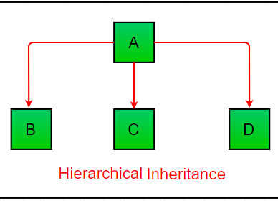
Hierarchical inheritance
When more than one derived class are created from a single base this type of inheritance is called hierarchical inheritance. In this program, we have a parent (base) class and two child (derived) classes.

Slide 17
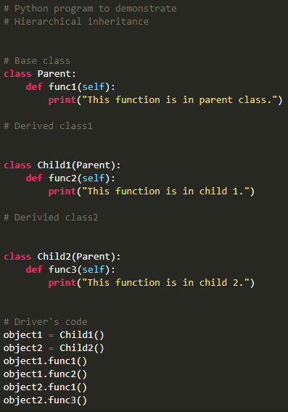
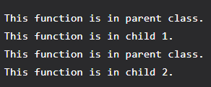
Hierarchical Inheritance sample

Slide 18
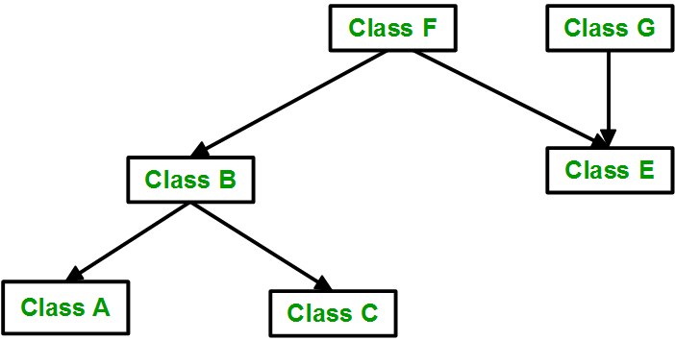
Hybrid inheritance
Inheritance consisting of multiple types of inheritance is called hybrid inheritance.

Slide 19
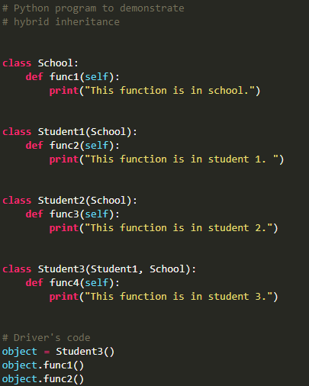

Hybrid inheritance sample

Slide 20
The super method

Slide 21
Definition and Usage
The super() function is used to give access to methods and properties of a parent or sibling class.
Allows us to avoid using the base class name explicitly
The super() function returns an object that represents the parent class.
Working with Multiple Inheritance

Slide 22
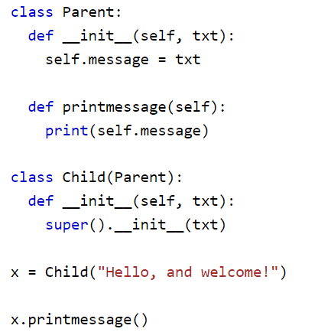

super()
Creates a class that will inherit all the methods and properties from another class:

Slide 23

Super() Function
Python super() function will make the child class inherit all the methods and properties from its parent:
The super() function now takes the __init__() of the Person class.
The super() function also prevents inconsistencies of reference when inheriting from a parent class.
Person properties/states

Slide 24
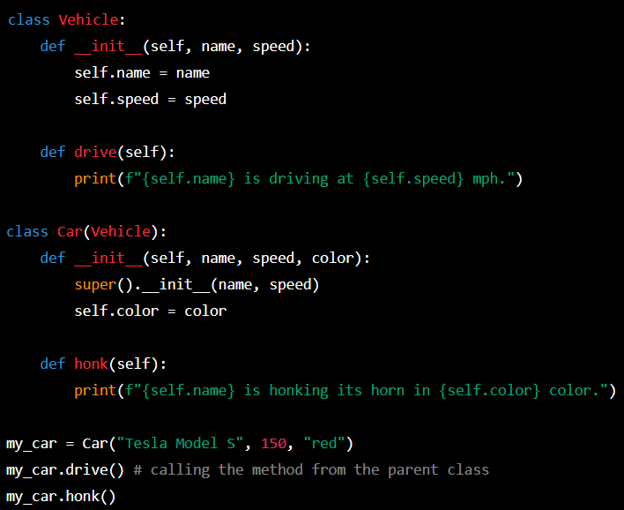
Example using super()
The super() builtin returns a proxy object (temporary object of the superclass) that allows us to access methods of the base class.

Slide 25
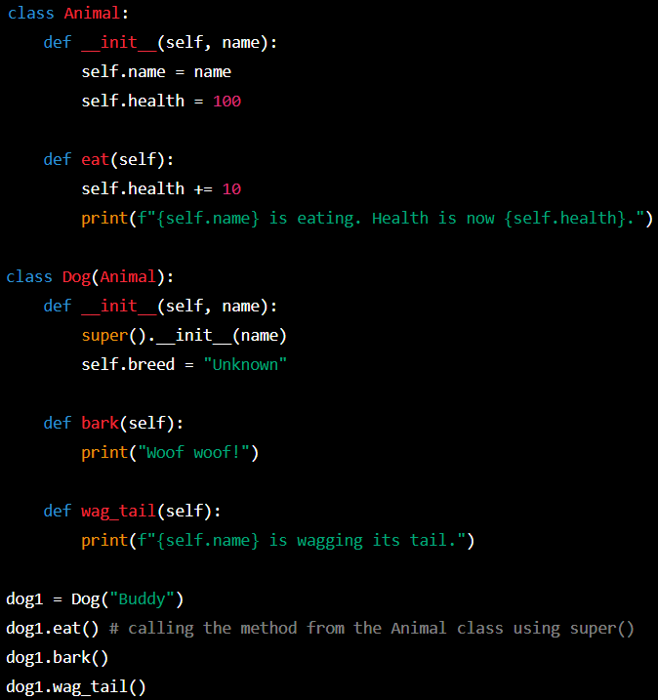
Using super() in single inheritance
In the case of single inheritance, we use super() to refer to the base class.

Slide 26
Method Resolution Order (MRO)

Slide 27
Method Resolution Order(MRO)
Denotes the way a programming language resolves a method or attribute.
Python supports classes inheriting from other classes. The class being inherited is called the Parent or Superclass, while the class that inherits is called the Child or Subclass.
In python, MRO defines the order in which the base classes are searched when executing a method.
First, the method or attribute is searched within a class and then it follows the order we specified while inheriting. This order is also called Linearization of a class and set of rules are called MRO.
While inheriting from another class, the interpreter needs a way to resolve the methods that are being called via an instance.

Slide 28
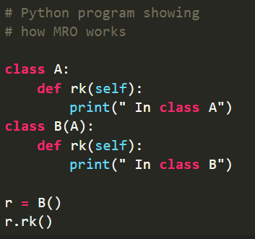

Python MRO Sample

Slide 29
Explanation
In the example the methods that are invoked is from class B but NOT from class A, and this is due to MRO.
The order that follows in the above code is class B – > class A
In multiple inheritances, the methods are executed based on the order specified while inheriting the classes.
For the languages that support single inheritance, method resolution order is not interesting, but the languages that support multiple inheritance method resolution order plays a very crucial role.

Slide 30
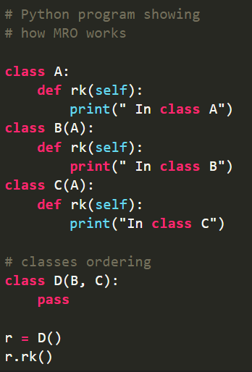

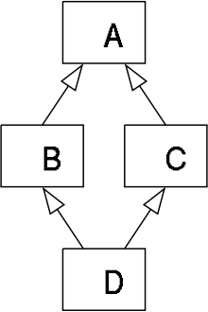
Additional MRO Example

Slide 31
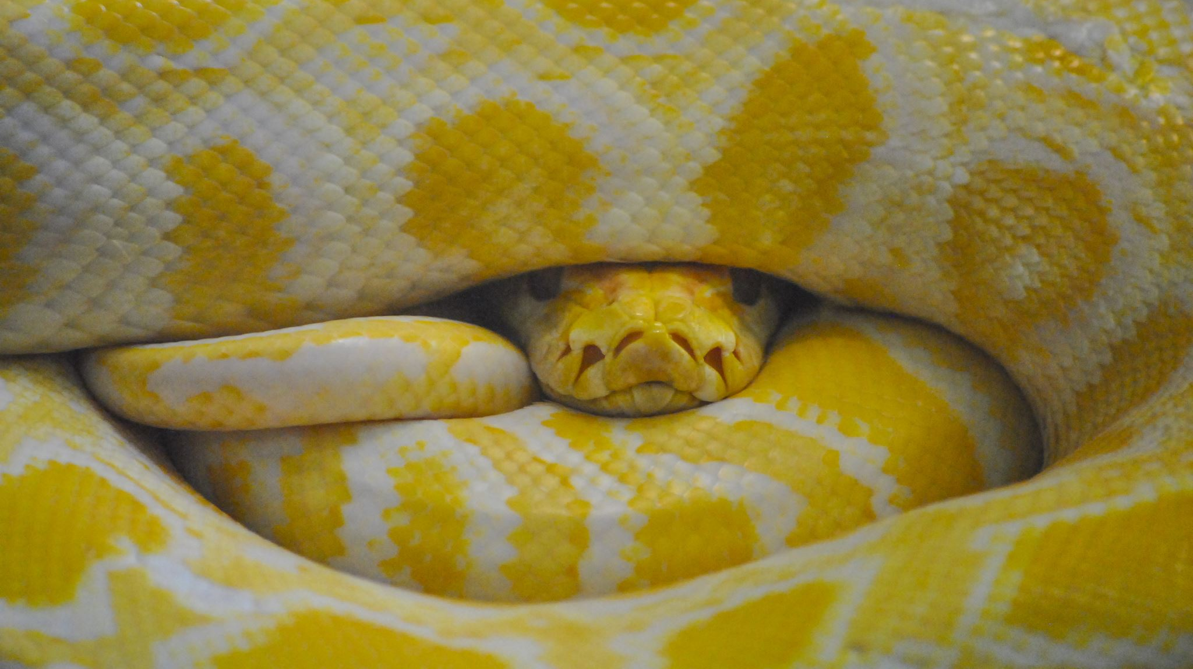
Diamond Inheritance Explanation
Python follows a depth-first lookup order and hence ends up calling the method from class A. By following the method resolution order, the lookup order as follows.
Class D -> Class B -> Class C -> Class A
Python follows depth-first order to resolve the methods and attributes.
Hence, from the previous example, it executes the method in class B.

Slide 32
REMINDER
MRO is from bottom to top and left to right. It’s a Depth-First-Search (DFS) Algorithm
The method is searched in the class of the object.
If it’s not found, it is searched in the immediate super class.
In the case of multiple super classes, it is searched left to right, in the order by which was declared by the developer.

Slide 33
More examples
def class C(B, A)
In this case, the MRO would be C -> B -> A.
Since B was mentioned first in the class declaration, it will be searched for first while resolving a method.

Slide 34
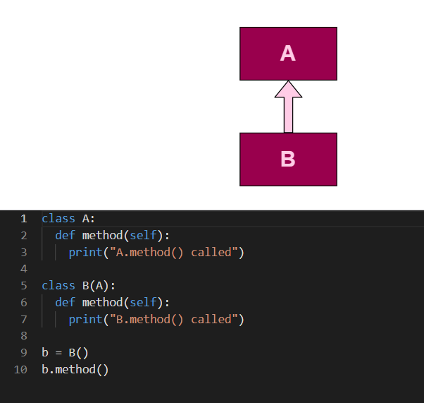
More examples
B -> A
B.method() called

Slide 35
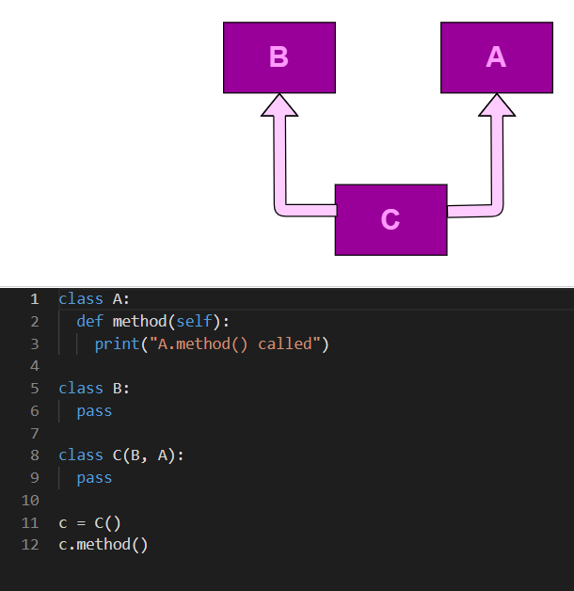
More examples
C -> B -> A
A.method() called

Slide 36
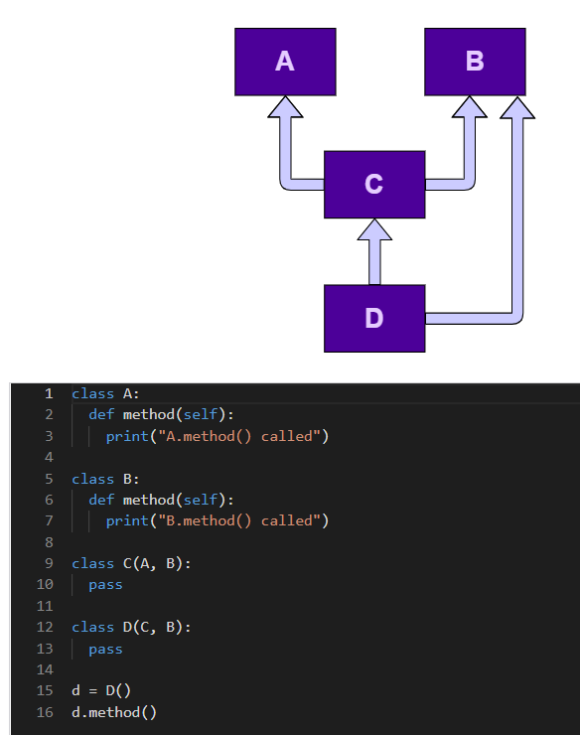
More examples
D -> C -> A -> B
A.method() called

Slide 37
Super and Inheritance via Explicit __init__
Method Resolution Order (MRO): When multiple inheritance is used, super() determines the order in which parent classes are searched for methods and attributes using the Method Resolution Order (MRO).
The MRO is a linear ordering of the inheritance graph that guarantees that every class's method is called only once.
By using super(), you can rely on Python's built-in MRO algorithm to determine the correct order of parent classes to call. If you reference the parent class directly, you may need to manually specify the order in which the parent classes are searched.

Slide 38
super vs explicit __init__

Slide 39
Super and Inheritance via Explicit __init__
Maintainability: Using super() can make your code more maintainable in case the inheritance hierarchy changes in the future. For example, if you add or remove a parent class, you may need to update all the references to the parent class in your code. Using super() eliminates the need to make such changes, as long as the new class has the same method signature as the old one.

Slide 40
Super and Inheritance via Explicit __init__
Flexibility: Using super() can make your code more flexible, as it allows you to override methods in intermediate classes without breaking the inheritance chain. If you reference the parent class directly, you will need to manually call the superclass's method to maintain the inheritance chain.

Slide 41
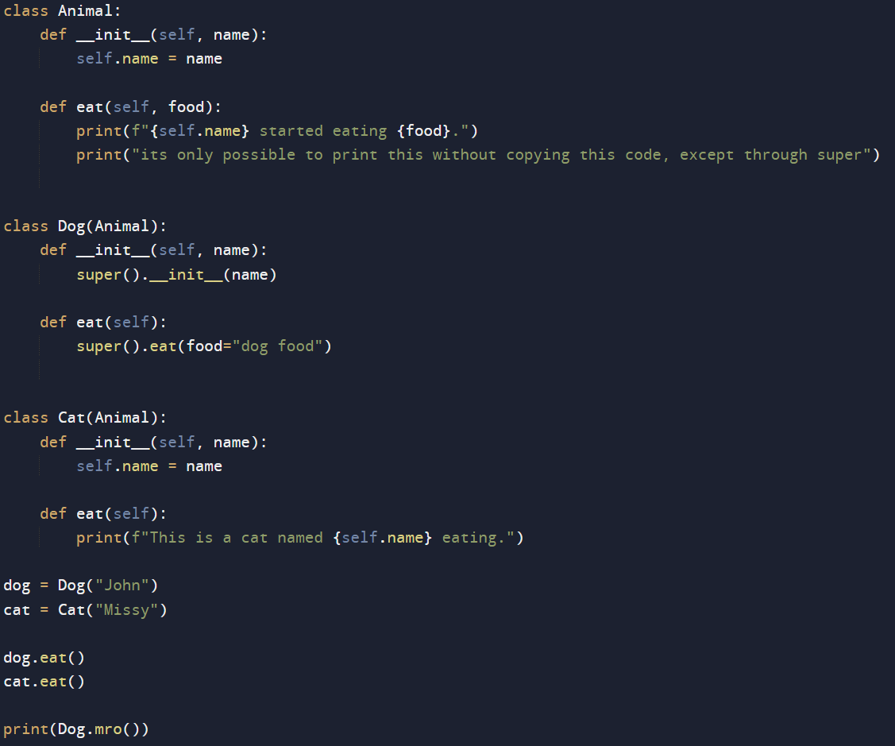
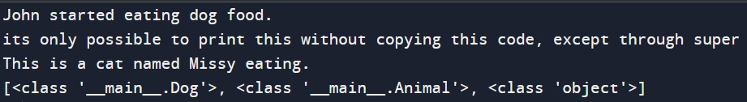
In the code, the use of super() in the Dog class is preferred over explicitly calling the eat method of the Animal class, because it makes the code more flexible and easier to maintain. However, in the Cat class, the __init__ method is not calling the __init__ method of the parent class at all, which can cause unexpected behavior if the Animal class has any important initialization logic. So, in this case, it would be better to use super() in the __init__ method of the Cat class to ensure that the parent class is properly initialized.

Slide 42

What should I use?

Slide 43
Super over explicit
USING SUPER:
Allows easier maintenance and modification of the class hierarchy. If you need to change the order of inheritance, or you add or remove a parent class, you won't have to update every reference to the parent class method in every subclass. Instead, you just update the super() call in the subclass.
Gives a more flexible inheritance. If you have multiple levels of inheritance, using super() ensures that you are calling the correct method in the correct parent class, regardless of the order of the inheritance.
Provides a more concise and easier to read code. When using super(), you don't have to repeat the name of the parent class or the method being called, which can make the code more readable and easier to understand.

Slide 44
Important Reason to use Super!
The reason why we super is that if in case that our parent that is providing inheritance changes, all of the other child classes inheriting from it will also require changes, may it be field names or behavior.
Such makes everything sophisticated, redundant, highly error prone, slows down production time, and can result to highly difficult maintenance!!
Super makes it easier to read code, modify, scale, and debug.

Slide 45
Further explainers
When a child class overrides a method from its parent class, it may still want to use the parent class's implementation of that method. By using super(), the child class can call the parent class's method and then add its own modifications.
When a child class needs to add new behavior to its parent class's method, it can call the parent class's method with super() and then add its own modifications before or after the parent class's code.
When a child class needs to override its parent class's __init__ method, it can use super() to call the parent class's __init__ method first and then add its own initialization code.

Slide 46
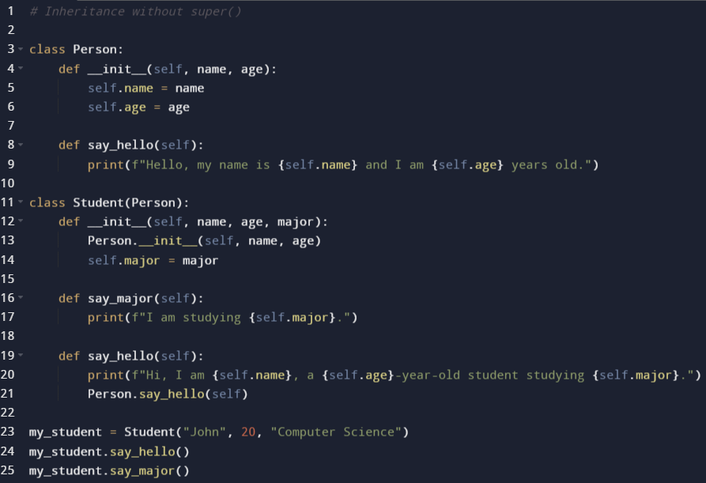
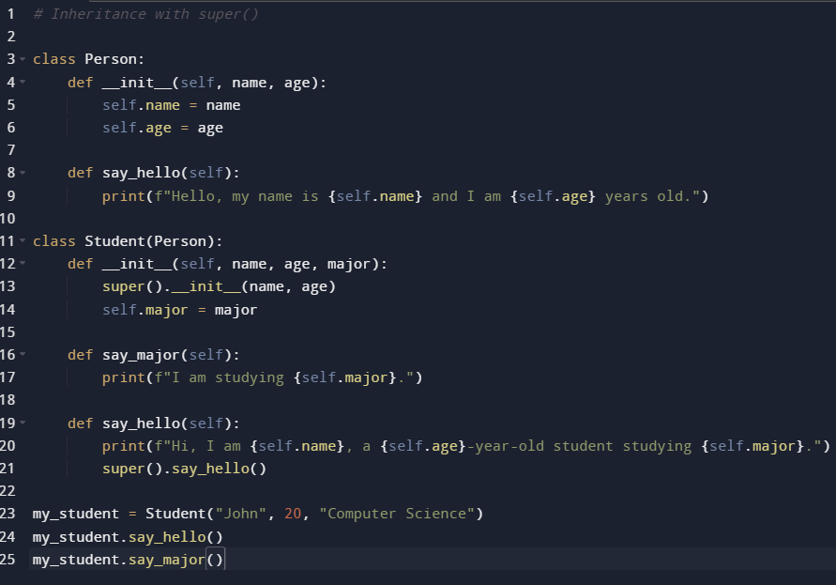
It’s a “syntactic sugar”

Slide 47
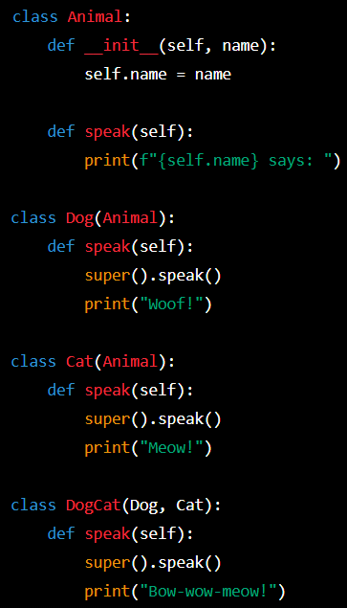
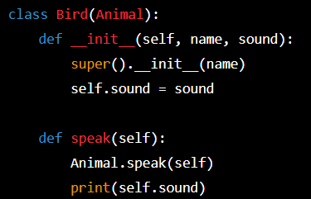
Codebase will most likely expand!
In this example, we have four classes: Animal, Dog, Cat, and DogCat. Dog and Cat both inherit from Animal. DogCat inherits from both Dog and Cat.
Each class has a speak() method, but Dog and Cat override the parent's speak() method to include the sound they make. DogCat also overrides speak(), but instead of choosing between Dog and Cat, it combines both sounds.
Now imagine we want to add a new class called Bird that inherits from Animal and has its own unique sound. Without super(), we would have to manually call the speak() method of each parent class in order to correctly output the sound of the Bird instance:
We have to manually call Animal.speak(self) to output the animal's name before outputting the bird's sound. If we added more classes and more levels of inheritance, it would become even more complex to correctly call all the parent's methods.
With super(), however, we can simply call super().speak() and it will automatically call the speak() method of the parent class in the order of inheritance, making it much easier to read and maintain:

Slide 48
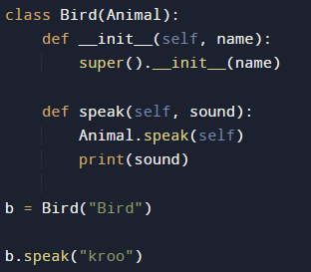
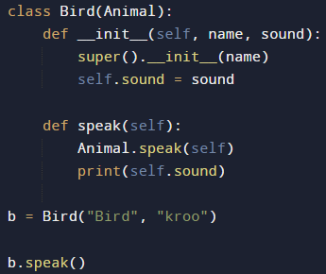
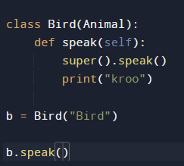

Without and With super for your inherited methods

Slide 49
Reminders about Inheritance

Slide 50
REMEMBER
Even with inheritance’s advantages, DO NOT ABUSE THEM, it can or might cause a diamond inheritance problem.
The "diamond problem" (sometimes referred to as the "Deadly Diamond of Death") is an ambiguity that arises when two classes B and C inherit from A, and class D inherits from both B and C.
You are engineering a software not illustrating an artwork.
Keep it simple and optimal.

Slide 51

How to solve this problem?
USE MIXINS!

Slide 52
Next Topics
More super with other forms of inheritance
Do’s and Don’ts of super()
Mixins
Compositions and Aggregations

Slide 53
Try me!
Create an OOP program that exemplifies inheritance in the following slide.

Slide 54




